Slide 1
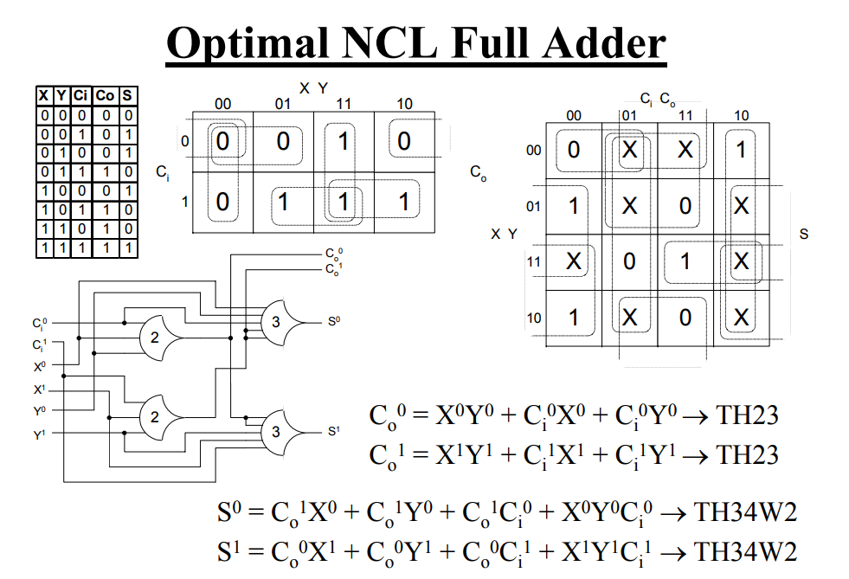
Optimal NCL Full Adder Circuit
7
8
Inputs List Format: Declaration_BitVectorSize_Input(s)
Inputs List: 0 1 1 2 3 4 5 6
1
9
7
Netlist Format: GateType_BitVectorSize_Output_Input(s)
2
TH34 Gate (Top)
TH23 Gate (Top)
3
Netlist:
4 1 7 1 3 5
4 1 8 2 4 6
13 1 9 1 3 5 8
13 1 10 2 4 6 7
4
5
TH23 Gate (Bottom)
8
10
6
TH34 Gate (Bottom)

Slide 2
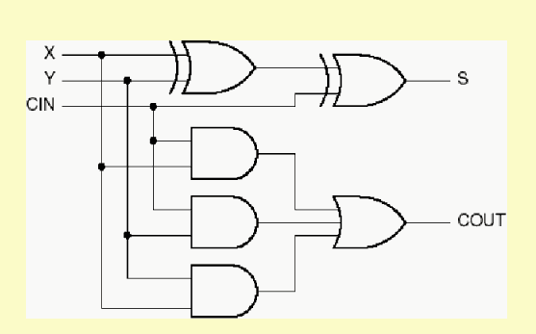
Synchronous Full Adder Circuit
Inputs List Format: Declaration_BitVectorSize_Input(s)
1
4
Inputs List: 0 1 1 2 3
XOR 1
8
2
XOR 2
Netlist Format: GateType_BitVectorSize_Output_Input(s)
3
AND 1
5
Netlist:
6 1 4 1 2
6 1 8 4 3
1 1 5 1 3
1 1 6 2 3
1 1 7 1 2
2 1 9 5 6 7
6
9
AND 2
OR 1
AND 3
7

